Slide 1
BANK MARKETING CASE
Group I

Slide 2
INTRODUCTION
Case background and relevance
DATA
AGENDA
Exploration, preprocessing and analysis
MODEL
Model building and parameters
MODEL IMPROVEMENT
Results and insights
RECOMMENDATIONS
Case recommendations
CONCLUSION
Questions and discussion

Slide 3
1
INTRODUCTION
Bank Marketing Scenario

Slide 4
BANK MARKETING CALLS
BANK
TERM DEPOSIT
CALLS
RELEVANCE
A Portuguese bank performed a marketing campaign, with the objective of having customers submit a term deposit.
It is a financial product offered by banks, where money is deposited for a fixed amount of time, offering the client a fixed return, usually higher than a regular account.
The campaign consists in cold calling potential clients and offering the service. Many clients were contacted in multiple times.
Cold calling is a common outreach technique. Targeting your customers correctly can provide is key, as it provides a higher conversion rate.

Slide 5
2
DATA

Slide 6
45211 CASES
INPUT TYPES
16 input variables
The variables could be split into 3 categories:
Client profile
Client account
Quality of the call
Integer
Categorical
Date
Binary
bank-full.csv
TARGET
PAST RESULTS
The “y” variable refers to whether or not a client completed a deposit as a result from the call.
This will be the target for our model.
yes: 5289 = 11.7%
no: 39922 = 88.3%
1 in every 9 calls results in a deposit

Slide 7
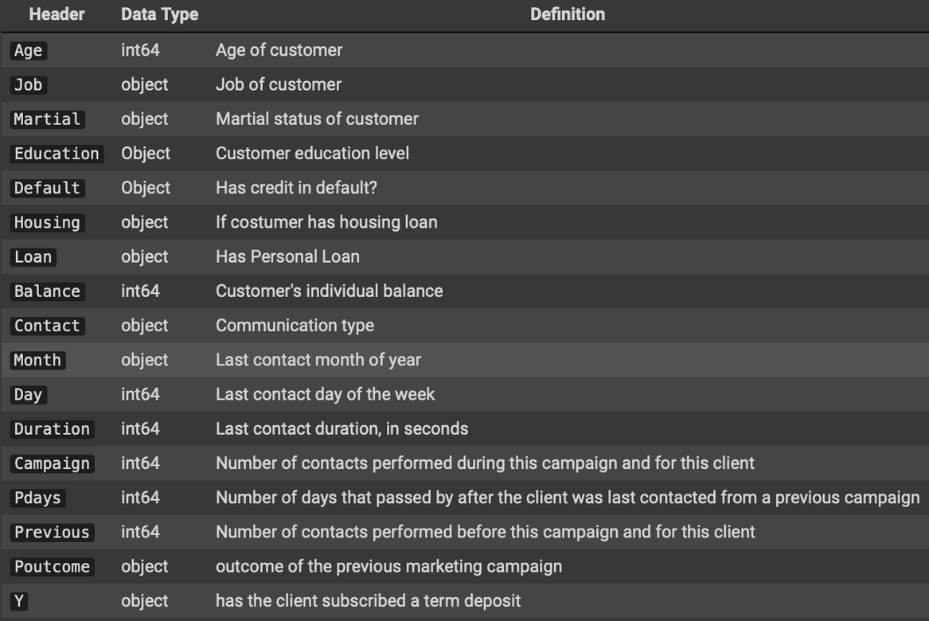
VARIABLES OVERVIEW

Slide 8
WHAT IS THE BEST MODEL TO PREDICT CLIENT DEPOSITS?
WHAT VARIABLES HAVE A HIGHER IMPACT ON THE DEPOSIT PROBABILITY?
BUSINESS QUESTION

Slide 9
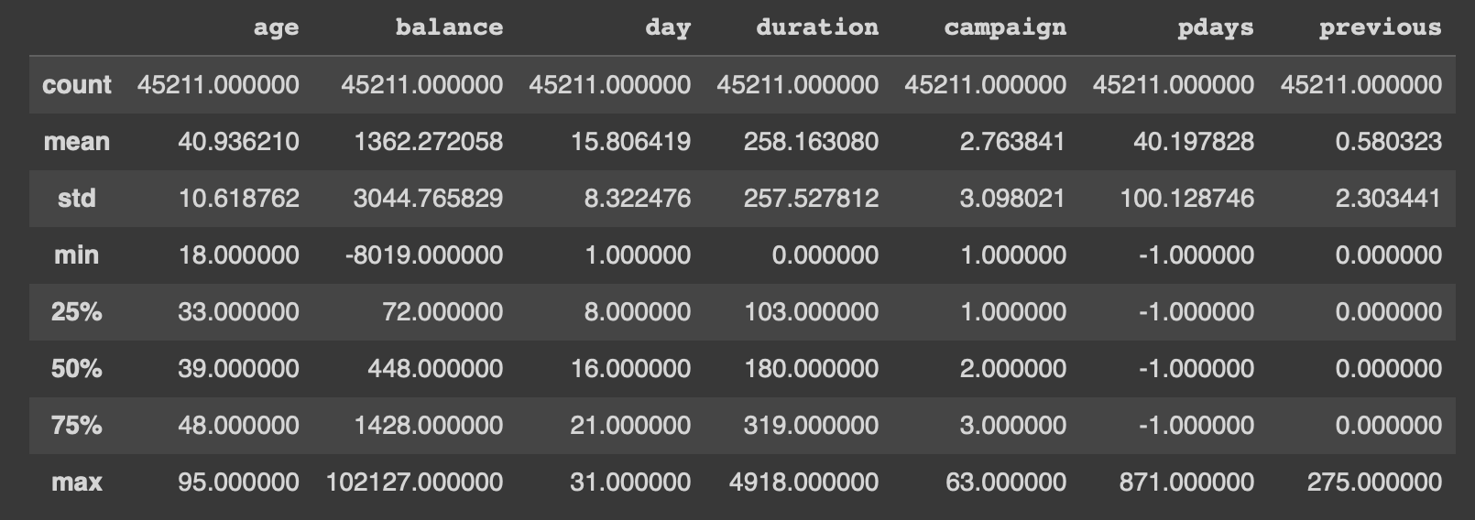
NUMERICAL VARIABLES

Slide 10
DATA PREPROCESSING
Remove outliers
Evaluate IQR
Remove null values and duplicates
Data Cleaning
Normalization
Encoding
MinMax Scaling for Numerical attributes
Oversampling

Slide 11
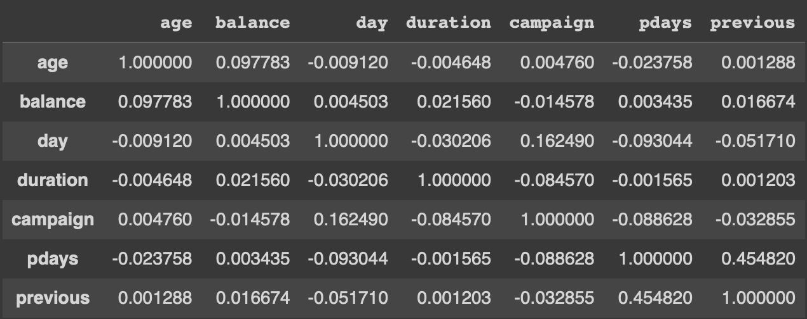
CORRELATION BETWEEN NUMERICAL FEATURES

Slide 12
3
MODEL TESTING

Slide 13
DECISION TREE
MODELS IMPLEMENTED
LOGISTIC REGRESSION
KNN
RAMDOM FOREST
XGBOOST
CONCLUSION

Slide 14
4
FINDINGS AND INSIGHTS

Slide 15
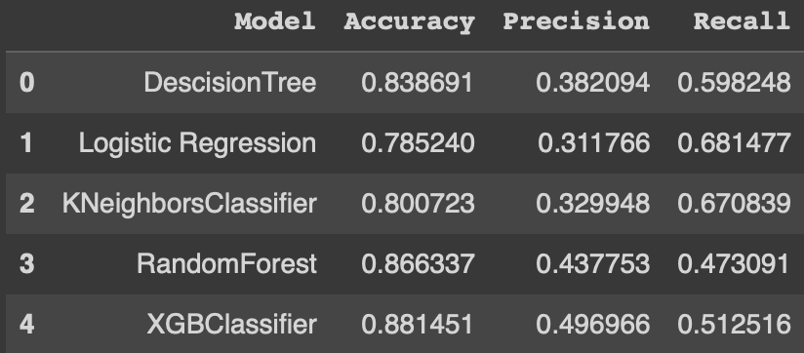
MODEL COMPARISON

Slide 16
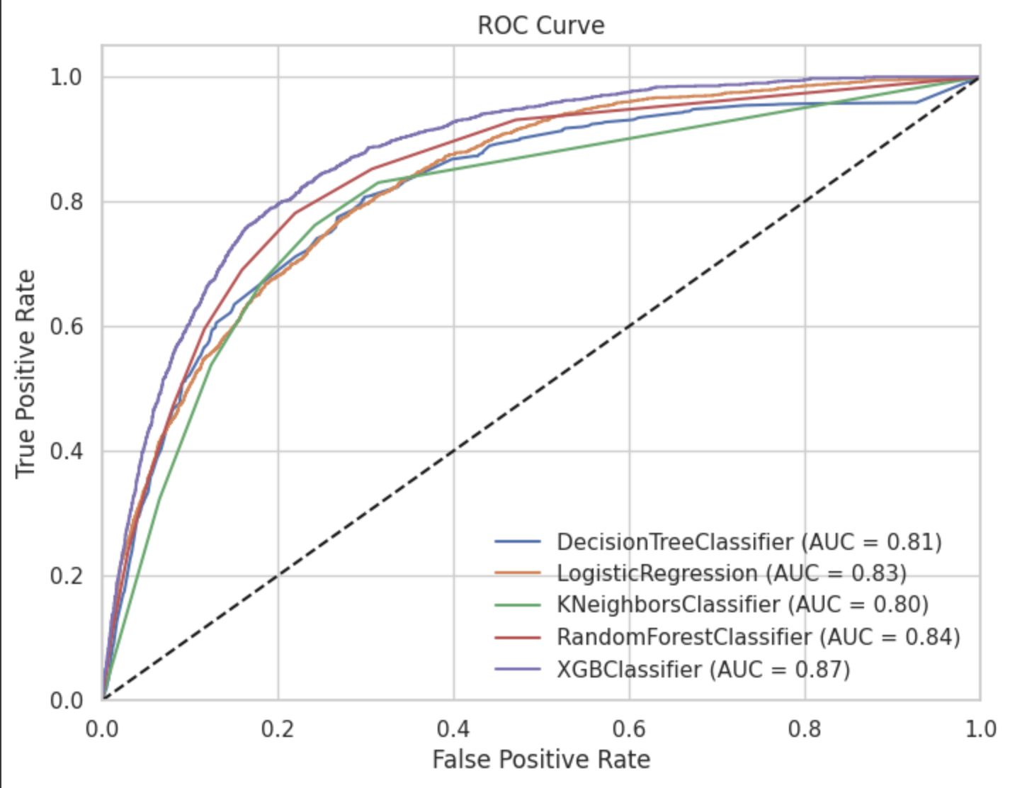
MODELS ROC CURVE

Slide 17
5
RECOMMENDATION

Slide 18
RECOMMENDATION
Model recommendations
Variables and correlations are highly imbalanced
Variables are significant, but as an overall interaction rather than individually

Slide 19
1
HIGHLY IMBALANCED DATASET
CONVERTED DATA INTO AN ACTIONABLE INSIGHTS
CONCLUSION
2
SUCCESFUL PREDICTIVE MODEL FOR FUTURE OUTCOMES
3

